Slide 1
Latency Compensation

Slide 2
Latency and how to Compensate
Need for Latency Compensation/Mitigation
Techniques
Latency Compensation and Cheating

Slide 3
What is Latency Compensation?
Latency compensation is the method of hiding network latency using various techniques, minimizing its effect so that the system appears responsive and accurate.
Some games can use simple techniques - delay and responsiveness is not critical.
Conservative/Pessimistic
Some games require more complex techniques that can lead to errors/inconsistent states, but are responsive to user actions and more effective at hiding latencies between systems.
Optimistic/Aggressive Algorithms

Slide 4
Impact
Inconsistent state between:
clients, and
client and server
In accuracies between views
Can cause inequities between players
Fairness
Scoring
Can disrupt play

Slide 5
CONSERVATIVE (Pessimistic) TECHNIQUES

Slide 6
Lockstep Synchronization
Only display updates of moves or actions when all clients have submitted their messages.
Can incur high delays – ie low reponsiveness on the clients
How can you guarantee that each client has responded?
Does a no response mean no action or a network loss
Have to incorporate an “alive” message from clients if they have sent no action message!
Can be implemented by client/server or P2P model.

Slide 7
Conservative Mitigation
Lock-step are simple examples of conservative simulations
Usually, there is no side-effect of the event you were waiting for
E.G. in Quake, a lot of the time the other player’s position is not important
Why wait for events? Why not just proceed
Answer is that you diverge IF you got shot
However, for many simulations you can decouple event sequences

Slide 8
Naïve (But Usable) Algorithms
Most naïve way to ensure consistency is to allow only one application to evolve state at once
One application sends its state, the others wait to receive, then one proceeds

Slide 9
Total Consistency (Alternating Execute)
Client A
Client B
T = t
Acknowledge every update
Propagation delay is 100ms

Slide 10
Total Consistency (Alternating Execute)
Client A
Client B
T = t + 50ms

Slide 11
Total Consistency (Alternating Execute)
Delta T
Client A
Client B
T = t + 50 ms + 100 ms
Delta T (latency) is 100ms

Slide 12
Total Consistency (Acknowledge Action)
Client A
Client B
T = t + 50ms + 100ms + 50ms

Slide 13
Total Consistency (Alternating Execute)
Delta T
Client A
Client B
T = t + 50ms + 100ms + 50ms + 100ms
T = t + 300ms
After 300ms Client A may move again!!!

Slide 14
Lock-Step (1) – Peer to Peer (P2P)
If all clients can deterministically act on the input data
Then a more useful form lock-step for NVEs & NGs is that everyone exchange input, proceed once you have all the information from other clients
But for many simulations, each step is only determined by user input, so can just communicate input

Slide 15
DOOM (1) – iD Software
Doom Client_{A}
Doom Client_{C}
Read
Input
Read
Input
Receive
Input
Receive
Input
Doom Client_{B}
Simulate
Simulate
Read
Input
Rendering
Rendering
Receive
Input
Simulate
Rendering

Slide 16
Lock-Step (2) – Client Server (C/S)
If the simulation is complex or non-deterministic, use a server to compute the state
Clients are locked to the update rate of the server
Note that own input is delayed (low responsiveness)

Slide 17
Quake (1 Pre-QuakeWorld) – iD Software
Quake Client_{A}
Quake Server
Quake Client_{B}
Mouse
Keyboard
Mouse
Keyboard
Read
Input
Receive
Input
Read
Input
Rendering
Simulate
Rendering
Draw
Lists, Game State
Draw
Lists, Game State
Notes:
Figure 11.5

Slide 18
Time
Real-time synchronization needs a notion of time
IF every event could be time stamped you could accurately reconstruct the recent past
In reality clocks on machines can not be synchronized
Can get close with Network Time Protocol
Still not sufficient, applications tend to measure inter-client latency using round-trip times

Slide 19
Virtual Time
Sometimes it is sufficient to be able to order events
Lamport’s Virtual Time is really an event counter
An event can indicate which events caused it, and which it depends on
Thus, e.g. say Event_{Explode} caused Event_{Fire}
If Event_{Explode} says “Event_{Fire} caused me” then anyone who has Event_{Explode} waits for Event_{Fire}
This can be implemented for simple situations with just incremental counting (Event_{N+1} is held until Event_{N} is played)

Slide 20
Causal Ordering of Events
Each client has its own clock and virtual time associated with the game
Clients know that certain actions cannot occur before others.
E.g., explode action cannot happen before fire/shot
Playout events based upon when a message is received and its dependency.
Depencies can get complex and long
Requires Time Warping to recover from errors.

Slide 21
OPTIMISTIC ALGORITHMS

Slide 22
Optimistic Algorithms
Conservative simulations tend to be slowed paced
Optimistic algorithms play out events as soon as possible
Of course, this means that they can get things wrong:
They may receive an event that happened in the past
To fix this they rollback by sending UNDO events
For many simulations UNDO is easy (just move something)

Slide 23
Aggressive Mitigation Techniques
There are various methods that can be applied to compensate for latency or mute/minimize its effect on the game play:
Optimistic Algorithms
Prediction
Player/Client – dead reckoning
Player/Opponent
Time Manipulation
Time Delay
Time Warp
Data Compression
Visual Tricks

Slide 24
Getting Things Wrong…..
Lock Door
t₀
Open
Door
t₁
Close
Door
Add
Zombies
t₂
Remove
Zombies
t₃
t₄
Client_{A}
Client_{B}
Client_{C}
Notes:
Figure 11.10

Slide 25
Prediction
Client Prediction – immediate feedback on local client
Opponent Prediction (Dead reckoning) – extrapolation based upon data received from opponent.
Many different implementations with smoothing algorithms to reduce jerkiness and bizarre situations with walking thru walls, etc.

Slide 26
CLIENT PREDICT AHEAD

Slide 27
Predict Ahead
A form of optimism: assume that you can predict what a server (or another peer) is going to do with your simulation
Very commonly applied in games & simulations for your own player/vehicle movement
You assume that your control input (e.g. move forward) is going to be accepted by the server
If it isn’t, then you are moved back
Note this isn’t forwards in time but a prediction of the current canonical state (which isn’t yet known!)

Slide 28
Player Prediction - Steps
The client takes input from the user (player)
The client predicts the server response only for the local player's actions
The player’s actions are not subjected to the round trip delay (to the server and back), thus removing any network latency
The game appears very responsive -> like a non-networked game

Slide 29
Client Moves and Server Echos Moves
Move?
P₀ _{to} P₁
P₀
P₁
Move?
P₁ _{to} P₂
Move
P₀ _{to} P₁
P₁
P₂
P₀
P₁
Move?
P₂ _{to} P₃
Move
P₁ _{to} P₂
P₂
P₃
P₁
P₂
Move?
P_{3 to} P₄
Move
P₂ _{to} P₃
P₃
P₄
P₂
P₃
Client_{A}
Server
Notes:
Figure 11.11

Slide 30
Drawbacks:
If there is a discrepancy between the game server response and the client side prediction, the client needs to make the adjustment in the game state (client thinks he shot someone, but the other player could have moved at the same time)
These adjustments could be abrupt and could cause jitter and deteriorate the consistency/flow of the game.
A client could use Interpolation, between the rendered local world and the server update showing the position of units at a later time
instead of immediately rendering the latest update the client interpolates the world at intermediate states, allowing the local world state to progress smoothly to the server world state.
NOTE: There is trade-off between game responsiveness and game consistency

Slide 31
Server Adjusts Position – Client Reacts
Move?
P₀ _{to} P₁
P₀
P₁
Move?
P₁ _{to} P₂
Move
P₀ _{to} P₁
P₀
P₁
P₁
P₂
Move?
P₂ _{to} P₃
FailMove
P₁ _{to} Q₁
P₁
P₂
P₃
Q₁
Q₁
FailMove
P₁ _{to} Q₁
Q₁
P₂
P₃
Client_{A}
Server
Notes:
Figure 11.12

Slide 32
Three approaches to client behavior when correction is called for: - Stop and wait - Move around and continue - Walk right thru and continue
Client Behavior for Corrections
Notes:
Figure 11.13

Slide 33
Prediction Algorithm - Summary
Sample user input
Pack up data and send to server
Determine visible objects and game state
Render scene based on local actions
Receive updates from server and unpack
Correct for any discrepancies (new state space reflecting other player actions and system changes)
Repeat

Slide 34
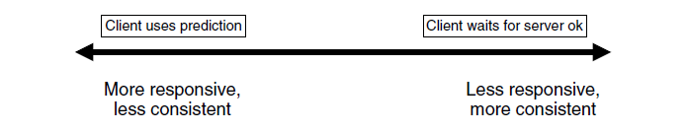
Impact of Player Prediction:
Responsiveness and consistency tradeoff – more responsive less consistent/accurate

Slide 35
Opponent Prediction - EXTRAPOLATION ALGORITHMS

Slide 36
Opponent Prediction – Dead Reckoning
In this technique the location and movement of an opponent's unit is predicted by the client
It starts on the basis of the opponent’s unit's last known position:
Client computes the current predicted position based on the unit's speed, acceleration and direction of movement.
This information is provided by the opponent - updates.
The predicted positions of the opponent's unit are used until the opponent sends an update for the new position. because the current predicted position falls outside of an acceptable position range threshold - ERROR.

Slide 37
Updates
The update is sent when the unit owner determines that the other players are not able to accurately predict the position within the predetermined threshold
Predetermined threshold refers to the acceptable range around the actual position of the opponent, where the predicted opponent's unit can be placed and considered to be a correct position. Often depends on size of object…… and objective of play.

Slide 38
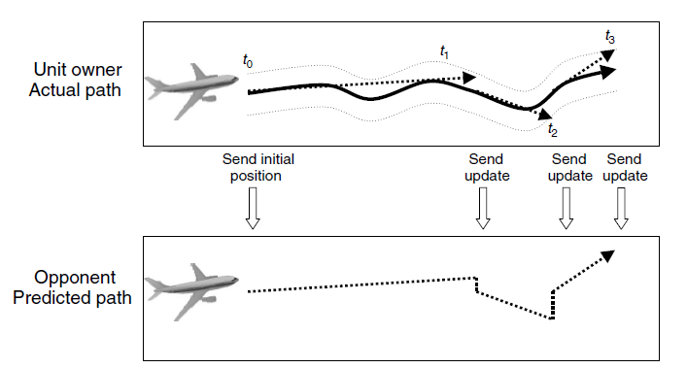
Opponent Prediction Cont'd

Slide 39
Opponent Prediction Explained
The picture shows the view by the owner of the unit.
The solid line in the middle shows the actual path as the player controlling the unit would see it.
The two thinner, dashed lines that run parallel to the middle line represent the threshold for the opponent predictions.
The thicker dashed lines represent the unit owner’s record/trace of the opponent’s prediction.
If the unit owner’s predicted location of the airplane goes outside this threshold, the unit owner sends a message to all opponents with an update on the new position and direction.

Slide 40
Opponent Prediction - Error
The initial position, velocity, acceleration, and direction is sent at time t₀, and subsequent updates are sent at t₁, t₂, and t₃.
The bottom picture depicts the view that the opponents would see.
The opponents use the last known position and direction to predict the unit location until an update is received, whereupon the new position and direction are used and the game view is corrected for any errors.

Slide 41
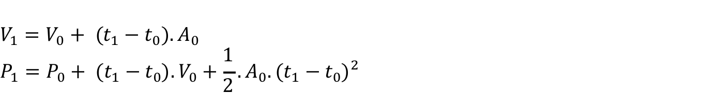
Prediction Model - Extrapolation
1st order model
2nd order model

Slide 42
Using Velocity Only with Position
1st Order Model

Slide 43
Adding Acceleration
2nd Order Model

Slide 44
Extrapolation Summary
Note that if this extrapolation is true you never need to send another event!
It will be wrong (diverge) if acceleration changes
BUT you can wait until it diverges a little bit (exceeds threshold) before sending events
The sender can calculate the results as if others were interpolating (a ghost), and send an update when the ghost and real position diverge beyond an acceptable ERROR threshold.

Slide 45
2nd Order Model with Error Threshold

Slide 46
Convergence Algorithm
When they do diverge, you don’t want the receiver to just jump: smoothly interpolate back again
This is hard:
Can linearly interpolate between old and new position over time – path interpolation strategy. Could cause problems such as direction of object may not be the same as direction of velocity.
Can have object change direction to follow new path, steering it in right direction – path planning strategy. Could cause a vehicle to make a sudden turn. Would not work for all objects.

Slide 47
Un-Smooth Convergence
t₂
t₁
t_{o}
a) Player model sending three
updates
b) Ghost model path without
blending
c) Old ghost model and new ghost
model at t₁

Slide 48
Path Interpolation Strategy
d) Blending between the old ghost and new ghost
over several frames
e) Ghost model path with blending

Slide 49
Convergence Algorithm
So you could steer the vehicle to correct its own position
This has frequency instabilities
Deals badly with obstacles as the interpolated path isn’t the same as the real path

Slide 50
Path Planning Strategy
Old ghost t₀
New ghost t₀+t_{Δ}
t₀
New ghost t₀
a) Old ghost position at t₀, new ghost position at t₀ and
new ghost position at t₀+t_{Δ}
b) Dotted line shows the planned path to
reach the target position and direction

Slide 51
Path Planning Strategy - Problems
Update at t₀
Update at t₁
a) Player model showing the timings of dead-reckoning updates at the peaks of a periodic motion

Slide 52
Path Planning Strategy – out of Sync
Player model update at t₀
Extrapolation of player model
Convergence path
Correct player model path
Ghost model location at t₀
b) On arrival of an update message, the ghost model plans to converge the current ghost model position with an extrapolation of the received position

Slide 53
c) On the next update message the ghost model is out of phase with the player model. T

Slide 54
Path Planning Strategy – No Convergence
t₁
t_{o}
Player model update at t₁
Path of ghost model after update at t₀
a) Player model showing the object avoiding the wall
b) After the update at t1 the ghost model cannot converge

Slide 55
Trade-offs of Opponent Prediction
It requires that each client run an algorithm to extrapolate the location of each opponent unit for each frame rendered
Smaller values for the update threshold can provide more fidelity in opponent's prediction at the cost of requiring more frequent updates:
requires higher bandwidth and processing overhead
On the other hand, larger values of the update threshold provide decreased fidelity and requires fewer updates:
lower update rate less bandwidth and lower processing overhead
This tradeoff depends on the game, the network, the client processor/hardware and the players’ preference.
Fairness – players further away get updates to locations later than others and so are at a disadvantage with seeing a wrong “game view”.
Solution: send clients further away more location updates.
NOTE: Errors in prediction can result in game disruptions.

Slide 56
Summary: Extrapolation Algorithms
Because we “see” the historic events of remote clients, can we predict further ahead (i.e. in to their future!)
This is most commonly done for position and velocity, in which case it is known as dead-reckoning
You know the position and velocity at a previous time, so where should it be now?
Two requirements:
Extrapolation algorithm: how to predict?
Convergence algorithm: what if you got it wrong?

